Slide 1
Chapter 6 Output

Slide 2
Chapter 6 Objectives
Describe the four categories of output
Summarize the characteristics of ink-jet printers, photo printers, laser printers, thermal printers, mobile printers, label and postage printers, and plotters and large-format printers
Summarize the characteristics of LCD monitors, LCD screens, plasma monitors, and CRT monitors
Describe the uses of speakers, headphones, and earphones
Describe the various ways to print
Identify the output characteristics of fax machines and fax modems, multifunction peripherals, data projectors, interactive whiteboards, joysticks, wheels, gamepads, and motion-sensing game controllers
Differentiate between a nonimpact printer and an impact printer
Identify output options for physically challenged users
Next

Slide 3
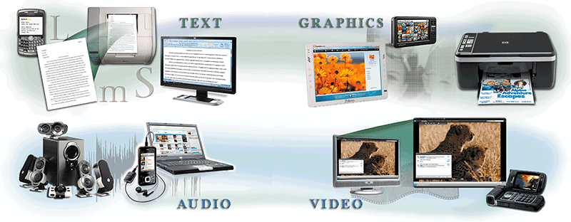
What is Output?
What is output?
Data that has been processed into a useful form
Output device is any hardware component that can convey information to one or more people
p. 300 - 301 Fig. 6-1
Next

Slide 4
Display Devices
What is a display device?
Output device that visually conveys text, graphics, and video information
Information on display device sometimes called soft copy
Monitor houses display device that is packaged as separate peripheral
p. 302
Next

Slide 5
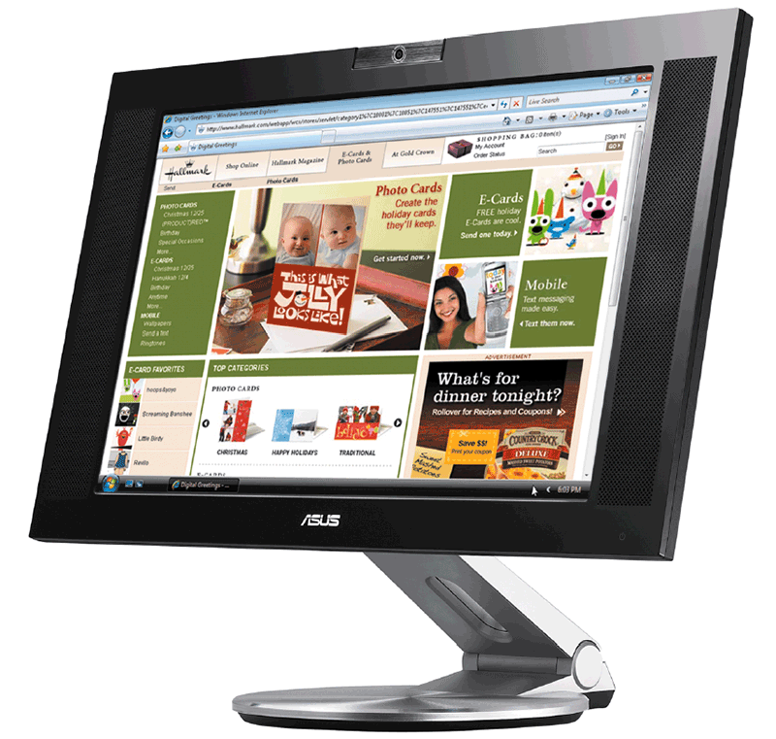
Display Devices
What is an LCD monitor?
Uses liquid crystal display
Has a small footprint
Mobile devices that contain LCD displays include
Notebook computer, Tablet PC, ultra personal computer, portable media player, smart phone, and PDA
p. 302 - 303 Fig. 6-2
Next

Slide 6
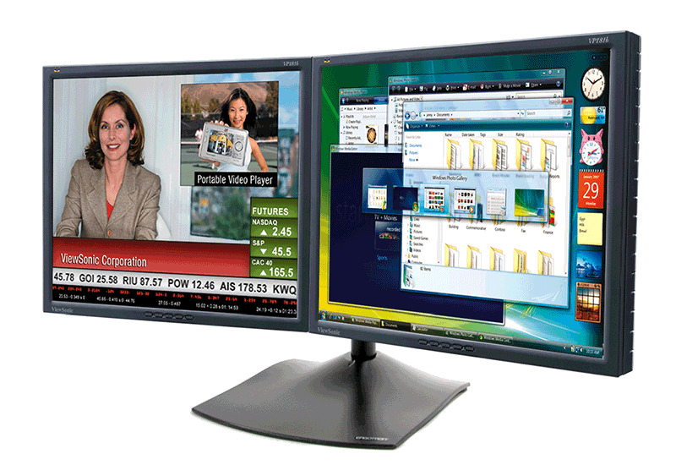
Display Devices
What about using multiple LCD monitors?
Some users position two or more monitors side-by-side or stacked
Allows users to run multiple applications simultaneously
p. 303 Fig. 6-3
Next

Slide 7
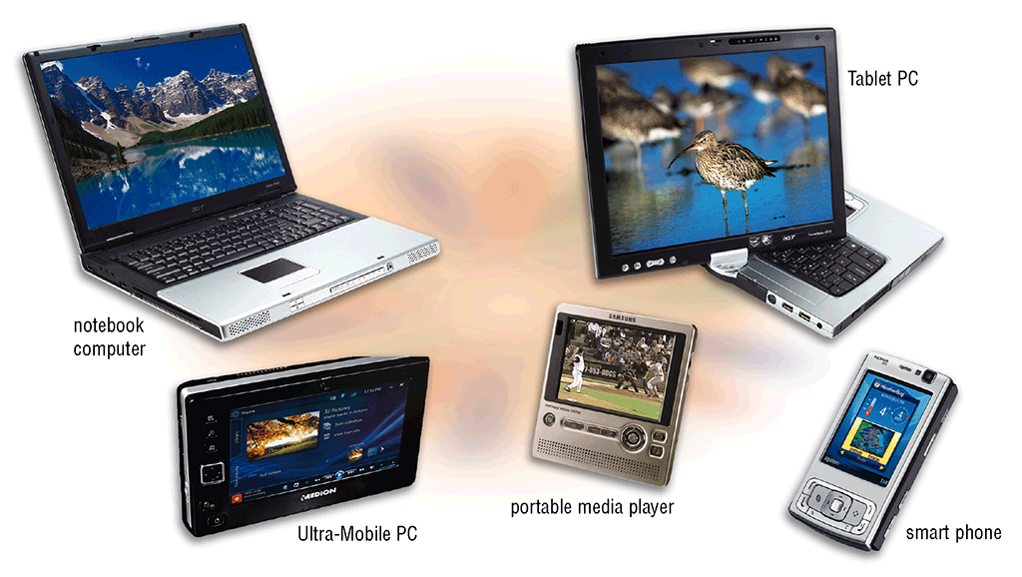
Display Devices
What are some mobile devices that have LCD screens?
Click to view Web Link, click Chapter 6, Click Web Link from left navigation,
then click Widescreen LCD Monitors below Chapter 6
p. 303 - 304 Fig. 6-4
Next

Slide 8

Display Devices
Video: SID: Size Matters
CLICK TO START
Next

Slide 9
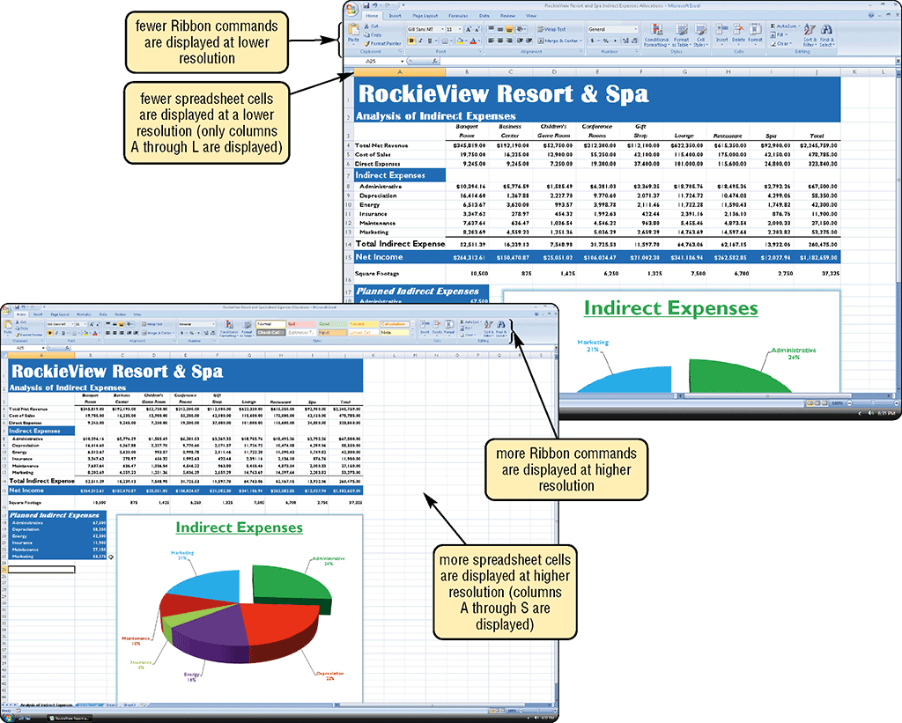
Display Devices
What is resolution?
Number of horizontal and vertical pixels in a display device
Sharpness and clarity of image
Higher resolution makes image sharper, displays more text on screen, makes some elements smaller
p. 304 - 305 Fig. 6-5
Next

Slide 10
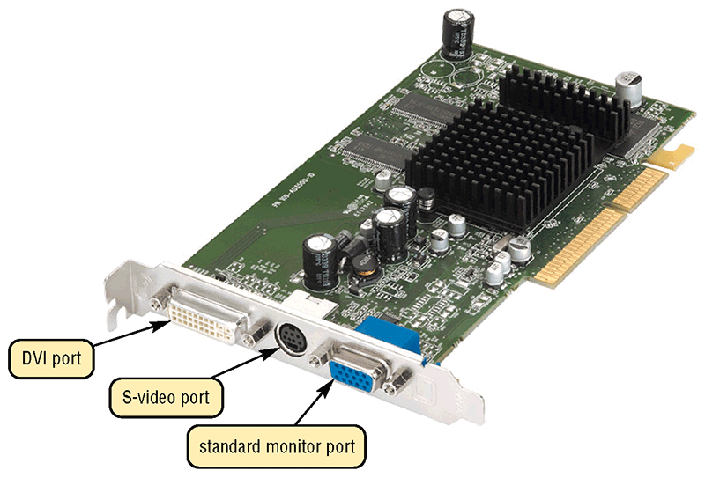
Display Devices
How do you use an LCD monitor with a video card?
Plug monitor into Digital Video Interface (DVI) port or an HDMI port on computer
Click to view Web Link, click Chapter 6, Click Web Link from left navigation,
then click Video Cards below Chapter 6
p. 306 Fig. 6-6
Next

Slide 11
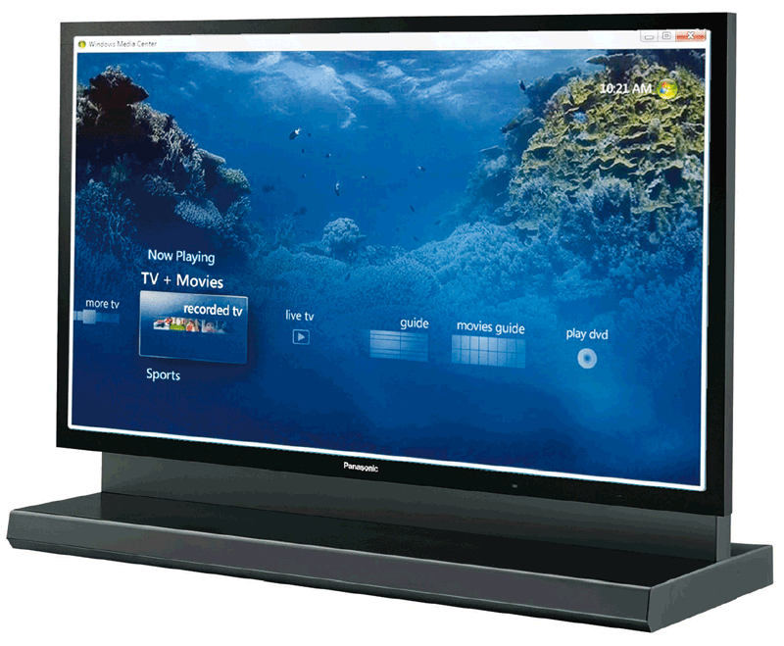
Display Devices
What is a plasma monitor?
Displays image by applying voltage to layer of gas
Larger screen size and richer colors than LCD, but are more expensive
p. 307 Fig. 6-8
Next

Slide 12
Display Devices
What is digital television (DTV) and high-definition television (HDTV)?
High resolution
All broadcast stations transmit digital signals
Many programs can be broadcast on a single digital channel
Uses digital signals to produce crisper, higher-quality output on LCD and plasma televisions
HDTV (high-definition television) is the most advanced form of digital TV
Great for game playing, watching movies, and browsing the Internet
p. 308
Next

Slide 13
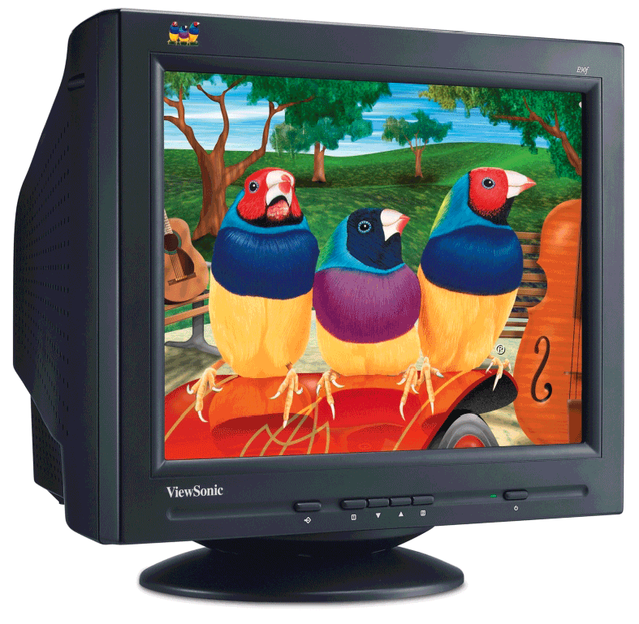
Display Devices
What is a CRT monitor?
Contains cathode-ray tube (CRT)
Screen coated with tiny dots of phosphor material
Each dot consists of a red, blue, and green phosphor
Common sizes are 15, 17, 19, 21, and 22 inches
Viewable size is diagonal measurement of actual viewing area
p. 309 Fig. 6-10
Next

Slide 14

Display Devices
What is the ENERGY STAR program?
Encourages manufacturers to create energy-efficient devices that require little power when not in use
Monitors and devices meeting guidelines display ENERGY STAR label
p. 309
Next

Slide 15


Printers
What is a printer?
Output device that produces text and graphics on a physical medium
Result is hard copy, or printout
Two orientations: portrait and landscape
portrait
landscape
p. 310 Fig. 6-11
Next

Slide 16
Printers
How do you know which printer to buy?
Depends on printing needs
Budget
Speed
Color or black and white
Cost per page
Multiple copies
Graphics and photo printing
Paper types and sizes
System compatibility
Future needs
Wireless capability
p. 310
Next

Slide 17
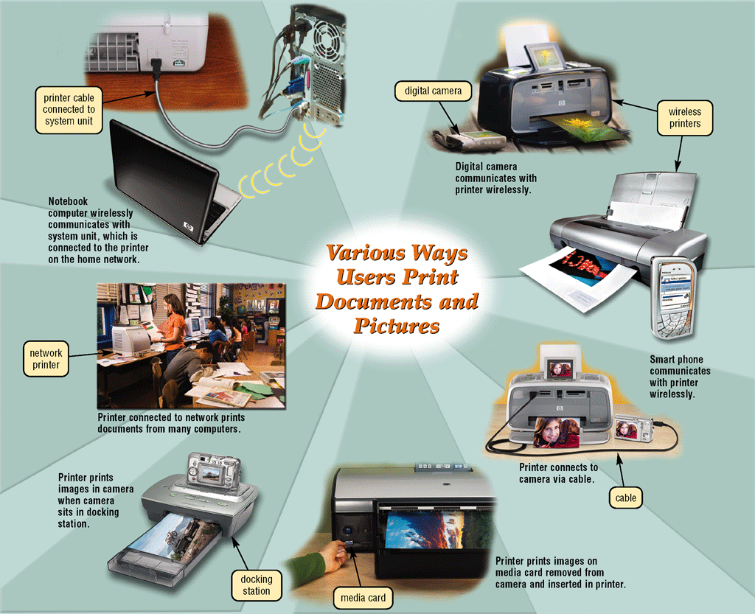
Printers
What are the various ways to print documents and pictures?
Click to view Web Link, click Chapter 6, Click Web Link from left navigation,
then click Printing Wirelessly below Chapter 6
p. 311 Fig. 6-13
Next

Slide 18
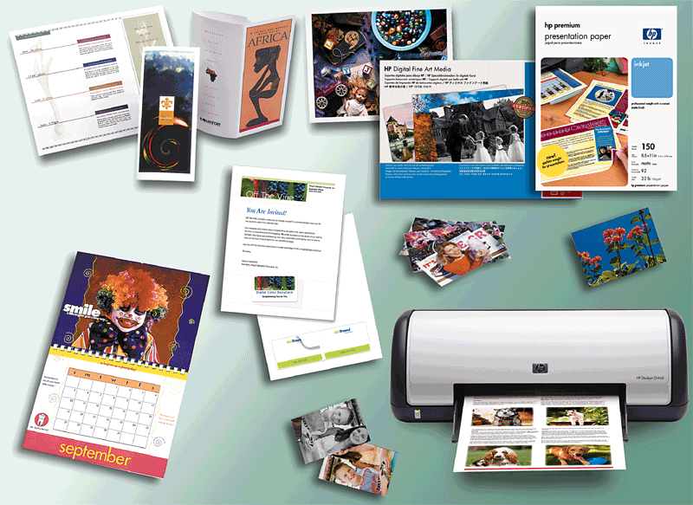
Printers
What is a nonimpact printer?
Forms characters and graphics without striking paper
Ink-jet printer sprays tiny drops of liquid ink onto paper
Prints in black-and-white or color on a variety of paper types
p. 312 Fig. 6-14
Next

Slide 19
Printers
What is the resolution of a printer?
Sharpness and clarity
Measured by number of dots per inch (dpi) printer can output
p. 313 Fig. 6-15
Next

Slide 20
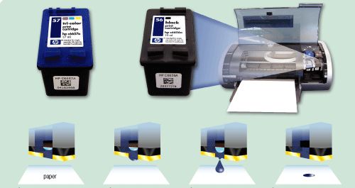
Printers
How does an ink-jet printer work?
print head
print cartridge
firing chamber
ink dot
bubble
resistor
ink
nozzle
Step 1. A small resistor heats the ink, causing the ink to boil and form a vapor bubble.
Step 2. The vapor bubble forces the ink through the nozzle.
Step 3. Ink drops onto the paper.
Step 4. As the vapor bubble collapses, fresh ink is drawn into the firing chamber.
Click to view Web Link, click Chapter 6, Click Web Link from left navigation,
then click Ink-Jet Printers below Chapter 6
p. 313 – 314 Fig. 6-16
Next

Slide 21
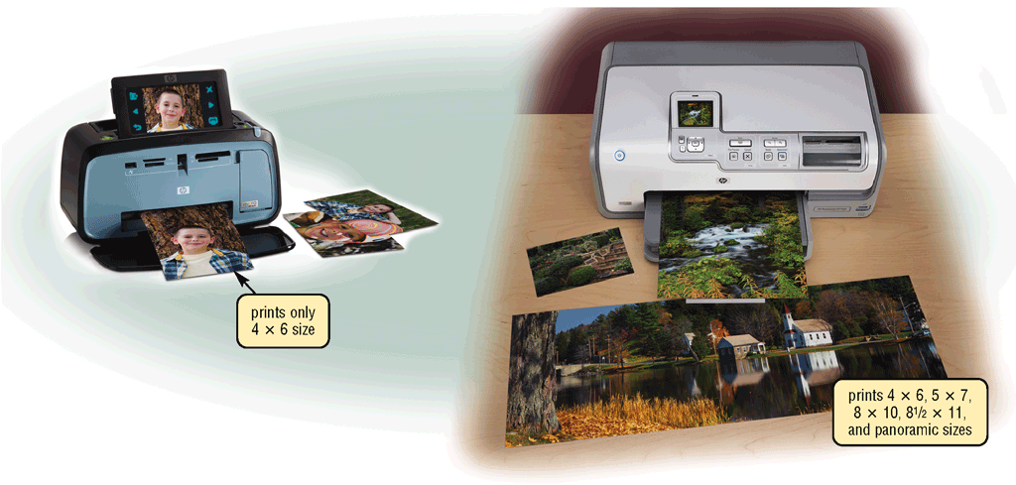
Printers
What is a photo printer?
Color printer that produces photo-lab-quality pictures
Many photo printers have a built-in card slot
PictBridge is a standard technology that allows you to print pictures directly from a digital camera
Click to view Web Link, click Chapter 6, Click Web Link from left navigation, then click PictBridge below Chapter 6
p. 314 - 315 Fig. 6-17
Next

Slide 22
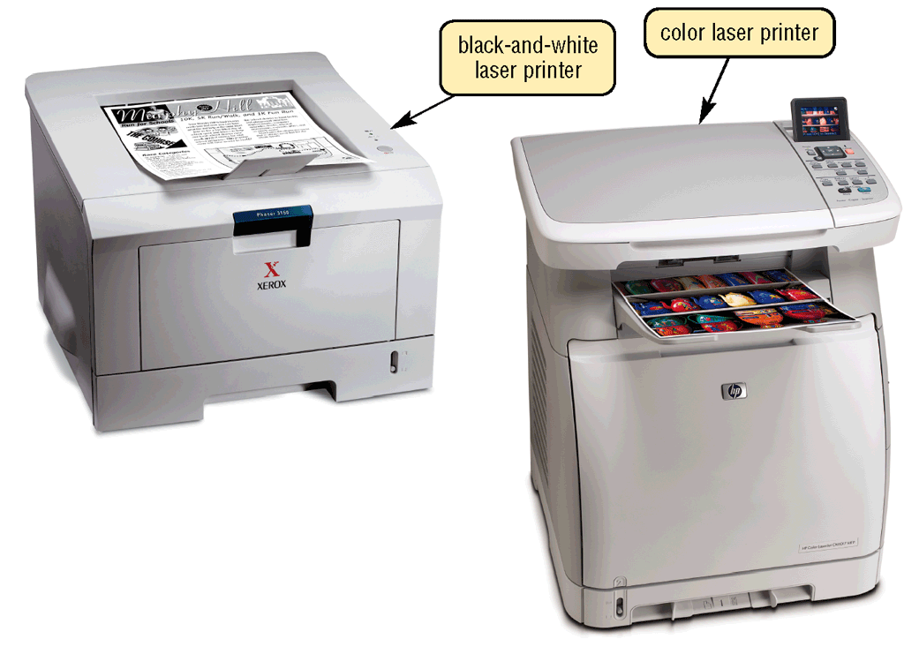
Printers
What is a laser printer?
High-speed, high-quality nonimpact printer
Prints text and graphics in high-quality resolution, ranging from 1,200 to 2,400 dpi
Typically costs more than ink-jet printer, but is much faster
p. 315 Fig. 6-18
Next

Slide 23
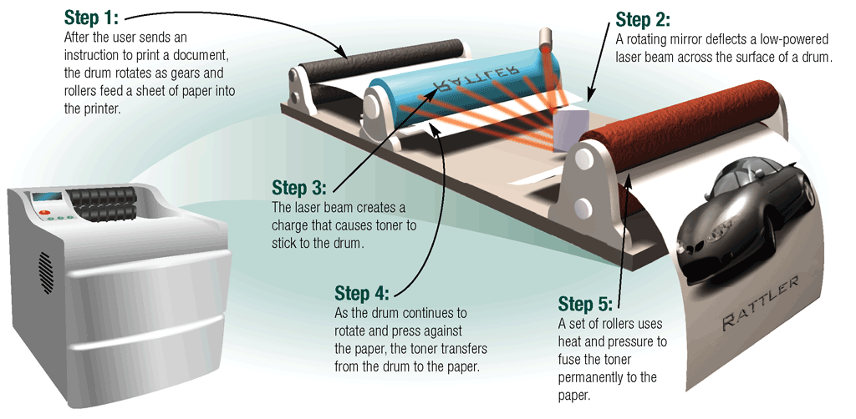
Printers
How does a laser printer work?
Click to view Web Link, click Chapter 6, Click Web Link from left navigation, then click Laser Printers below Chapter 6
p. 316 Fig. 6-19
Next

Slide 24
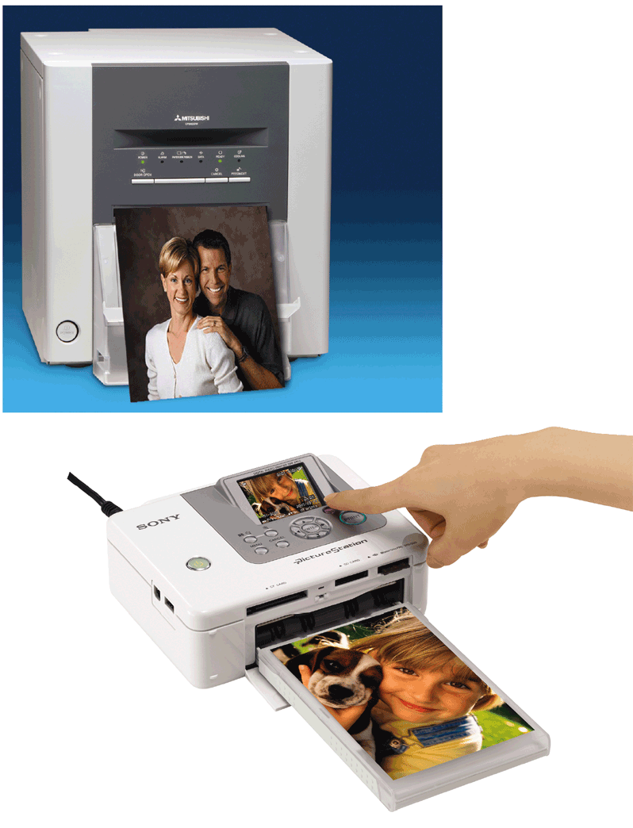
Printers
What is a thermal printer?
Generates images by pushing electrically heated pins against heat-sensitive paper
Dye-sublimation printer (also called a digital photo printer) uses heat to transfer dye to specially coated paper
p. 317 Fig. 6-20
Next

Slide 25
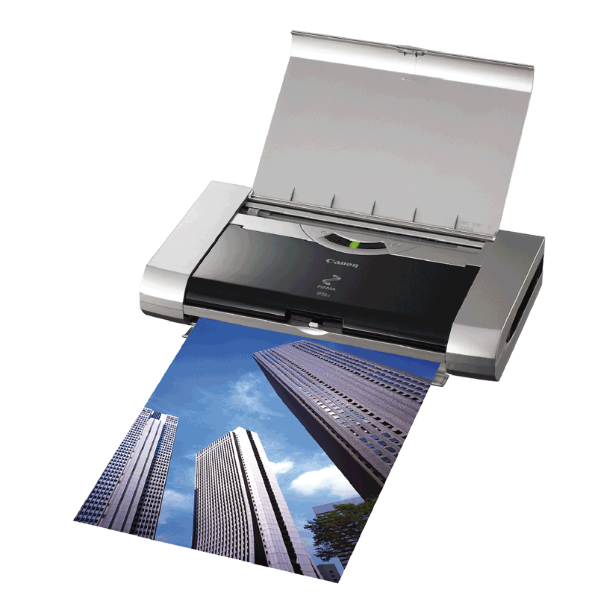
Printers
What is a mobile printer?
Small, lightweight, battery-powered printer that allows mobile user to print from notebook computer, Tablet PC, smart phone, or other personal mobile device while traveling
p. 317 Fig. 6-21
Next

Slide 26
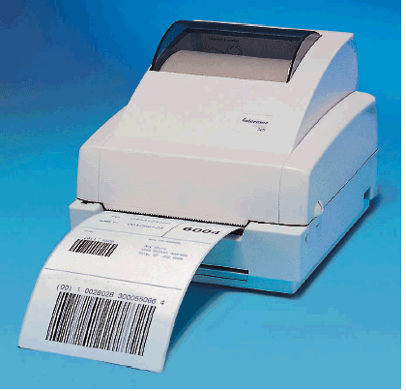
Printers
What are label printers and postage printers?
Small printer that prints on adhesive-type material
Most also print bar codes
Postage printer has built-in digital scale and prints postage stamps
p. 318 Fig. 6-22
Next

Slide 27
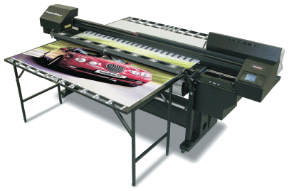
Printers
What is a plotter?
Sophisticated printer used to produce high-quality drawings
Large-format printer creates photo-realistic-quality color prints
p. 318 Fig. 6-23
Next

Slide 28
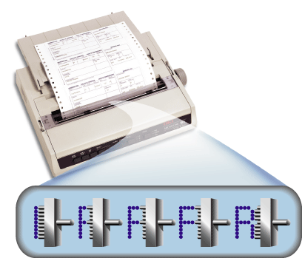
Printers
What is a dot-matrix printer?
Impact printer that produces printed images when tiny wire pins strike ribbon
Impact printer forms characters by striking mechanism against inked ribbon that contacts paper
p. 318 - 319 Fig. 6-24
Next

Slide 29
Printers
What is a line printer?
High-speed impact printer that prints entire line at a time
Speed measured in lines per minute (lpm)
Band printer prints fully formed characters using a hammer mechanism
Shuttle-matrix printer is high-speed printer that works like dot-matrix printer
p. 319 Fig. 6-25
Next

Slide 30
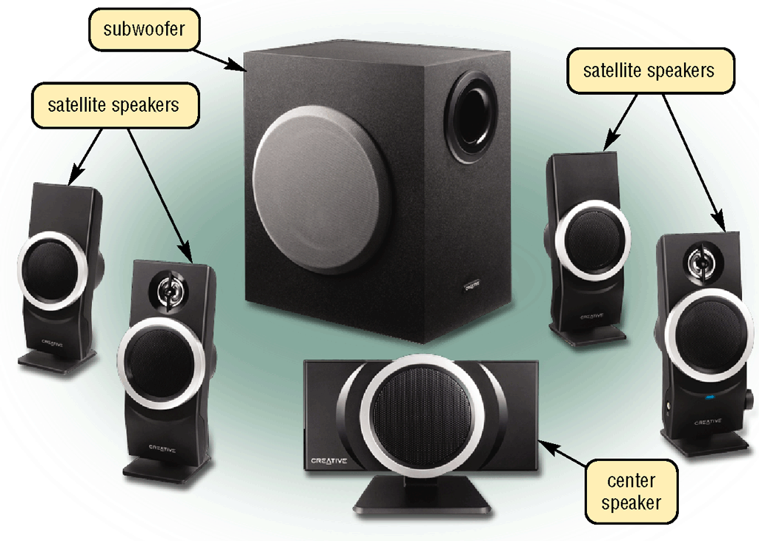

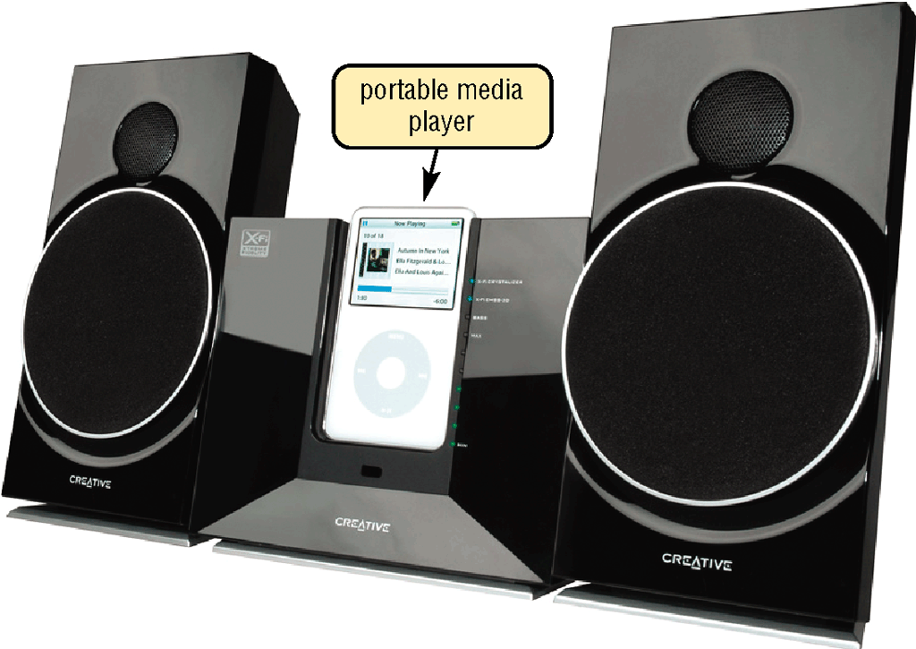
Speakers, Headphones, and Earphones
What is an audio output device?
Computer component that produces music, speech, or other sounds
Speakers and headsets are common devices
Click to view Web Link, click Chapter 6, Click Web Link from left navigation, then click Wireless Music System below Chapter 6
p. 320 - 321 Figs. 6-26 – 6-28
Next

Slide 31
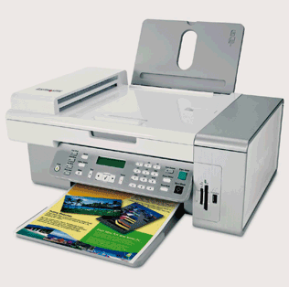
Other Output Devices
What is a facsimile (fax) machine?
Device that transmits and receives documents over telephone lines
Converts an original document into a digitized image
Many computers include fax capability
p. 322 Fig. 6-30
Next

Slide 32
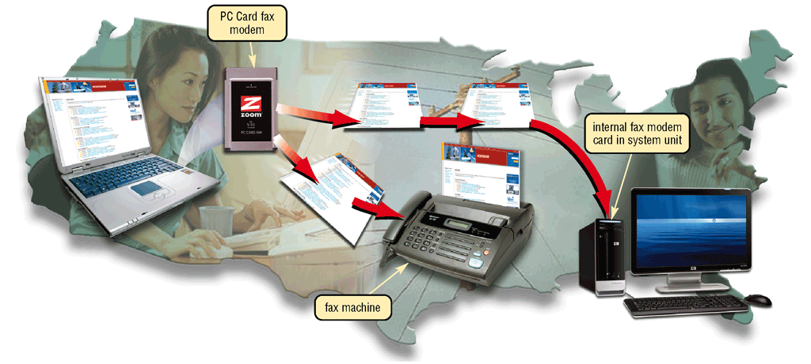
Other Output Devices
What is a fax modem?
Modem that allows you to send and receive electronic documents as faxes
Click to view Web Link, click Chapter 6, Click Web Link from left navigation, then click Fax Modems below Chapter 6
p. 322 Fig. 6-29
Next

Slide 33
Other Output Devices
What is a multifunction peripheral?
Provides functionality of printer, scanner, copy machine, and fax machine
p. 323 Fig. 6-30
Next

Slide 34
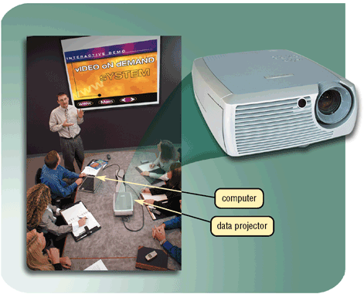
Other Output Devices
What is a data projector?
Device that takes text and images from computer screen and projects them onto larger screen
DLP projector
LCD projector
Click to view Web Link, click Chapter 6, Click Web Link from left navigation, then click LCD Projectors below Chapter 6
p. 323 Fig. 6-31
Next

Slide 35

Other Output Devices
What is an interactive whiteboard?
Touch-sensitive device that displays the image on a connected computer screen
SMART board
Click to view Web Link, click Chapter 6, Click Web Link from left navigation, then click SMART Board below Chapter 6
p. 324 Fig. 6-32
Next

Slide 36
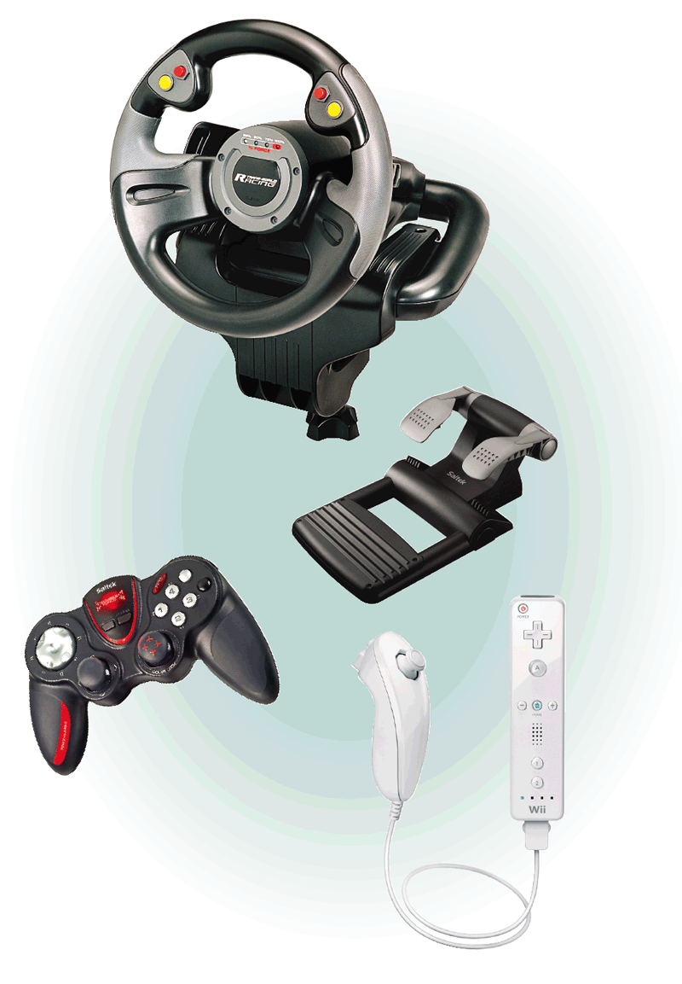
Other Output Devices
What is force feedback?
Sends resistance to device in response to actions of user
p. 324 Fig. 6-33
Next

Slide 37

Putting It All Together
What are suggested output devices for the home user?
Monitor
Printer
Other
17- or 19-inch LCD monitor, or 17-inch LCD screen on notebook computer
Ink-jet color printer; or
Photo printer
Speakers
Headphones or earphones
Force-feedback joystick, wheel, gamepad, and/or motion-sensing game controller
p. 325 Fig. 6-34
Next

Slide 38

Putting It All Together
What are suggested output devices for the small office/home office user?
Monitor
Printer
Other
19- or 22-inch LCD monitor
LCD screen on Tablet PC, smart phone, or other personal mobile device
Multifunction peripheral; or
Ink-jet color printer; or
Laser printer (black-and-white or color)
Label printer
Postage printer
Fax machine
Speakers
p. 325 Fig. 6-34
Next

Slide 39

Putting It All Together
What are suggested output devices for the mobile user?
Monitor
Printer
Other
17-inch color LCD screen on notebook computer
LCD screen on Tablet PC, smart phone, or other personal mobile device
Mobile color printer
Ink-jet color printer; or
Laser printer for in-office use (black-and-white or color)
Photo printer
Fax modem
Headphones or earphones
DLP data projector
p. 325 Fig. 6-34
Next

Slide 40

Putting It All Together
What are suggested output devices for the power user?
Monitor
Printer
Other
27-inch LCD monitor
Laser printer (black-and-white or color)
Plotter or large-format printer; or
Photo printer; or
Dye-sublimation printer
Fax machine or fax modem
Speakers
Headphones or earphones
p. 325 Fig. 6-34
Next

Slide 41

Putting It All Together
What are suggested output devices for the large business user?
Monitor
Printer
Other
19- or 22-inch LCD monitor
LCD screen on Tablet PC, smart phone, or other personal mobile device
High-speed laser printer
Laser printer, color
Line printer (for large reports from a mainframe)
Label printer
Fax machine or fax modem
Speakers
Headphones or earphones
Networked DLP data projector
Interactive whiteboard
p. 325 Fig. 6-34
Next

Slide 42
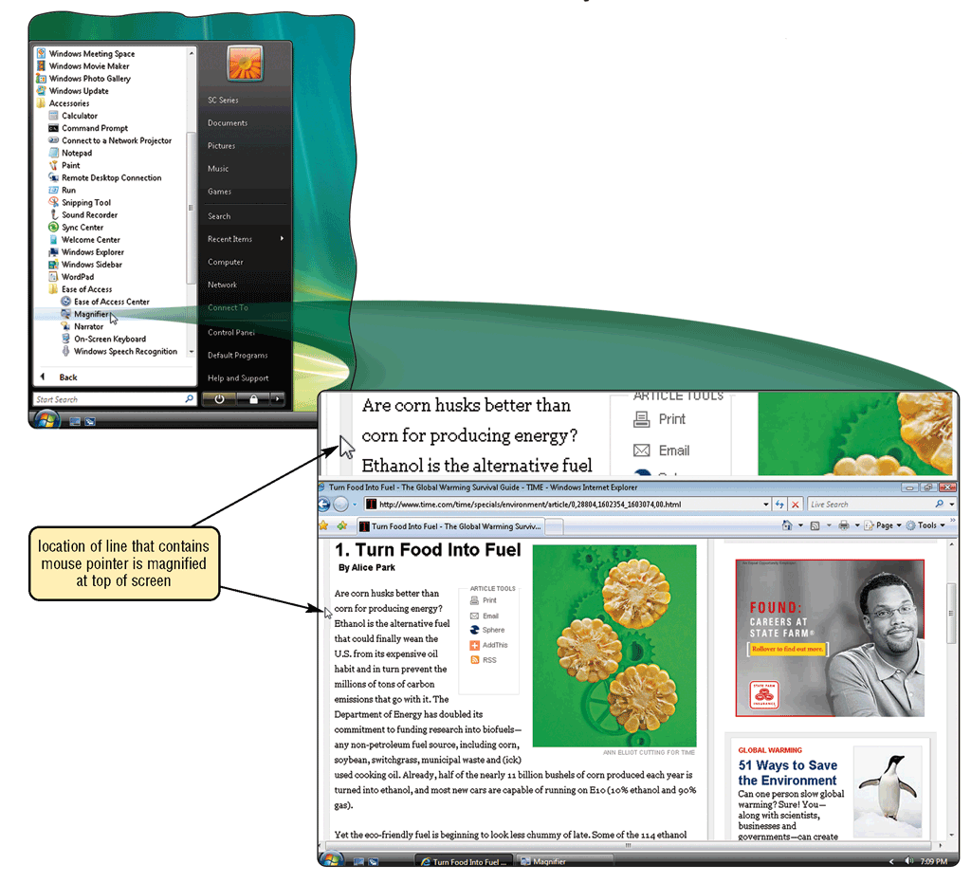
Output Devices for Physically Challenged Users
What is the Magnifier?
Windows Magnifier enlarges text and other items on screen
p. 326 Fig. 6-35
Next

Slide 43
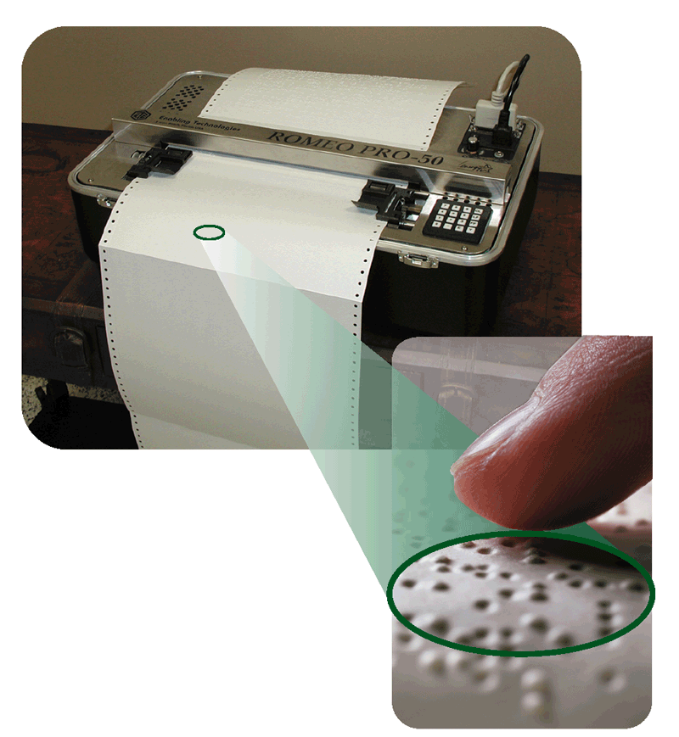
Output Devices for Physically Challenged Users
What other output options are available for visually impaired users?
Change Window settings, such as increasing size or changing color of text to make words easier to read
Blind users can work with Windows Vista’s Narrator
Braille printer outputs information in Braille onto paper
p. 326 Fig. 6-36
Next

Slide 44
Summary of Output
Display devices
Multifunction peripherals
Printers
Data projectors
Speakers, headphones, and earphones
Interactive whiteboards
Fax machines and fax modems
Force feedback joysticks, wheels, and gamepads
Chapter 6 Complete

